Slide 1
Colonoscopy Polyp Segmentation
Group 47
Members:
Do Hong Chung - 22BA13055
Nguyen Trong Minh Duc - 22BA13082
Computer vision
1

Slide 2
Contents
01 | Context and Motivation
02 | Objectives
03 | Product Overview
04 | AI Methodology
05 | Evaluation
06 | Conclusion
Computer vision
2

Slide 3
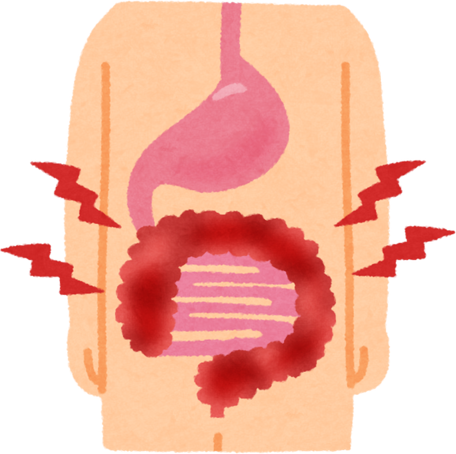
1 Context and Motivation
Context:
Colorectal cancer is one of the most common causes of death.
It begins with polyps (small clumps of cells on the colon lining).
They are benign initially, but over time they become cancer.
We must detect them early.
Challenge:
Detection still depends on endoscopy and visual inspection.
Polyps are difficult to see and the image quality is not always good.
Computer vision
3

Slide 4

2 Objectives
Goal:
Develop a reliable Polyp Segmentation and Risk Assessment System
System Capabilities:
Segment polyps from raw endoscopic images
Assess whether polyps are dangerous or not
Operates under many image conditions
Easy-to-used for everyone
Computer vision
4

Slide 5
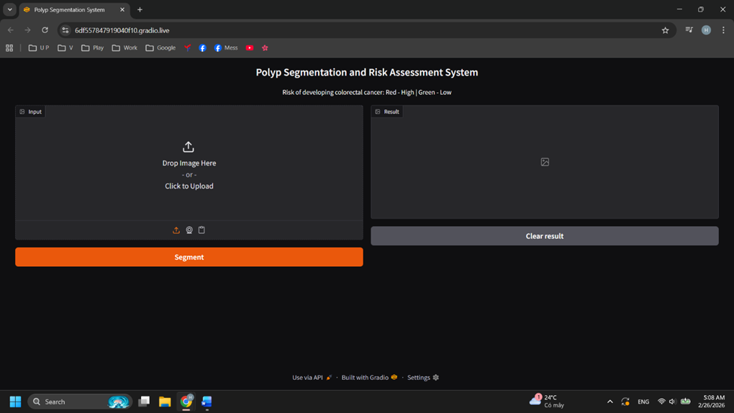
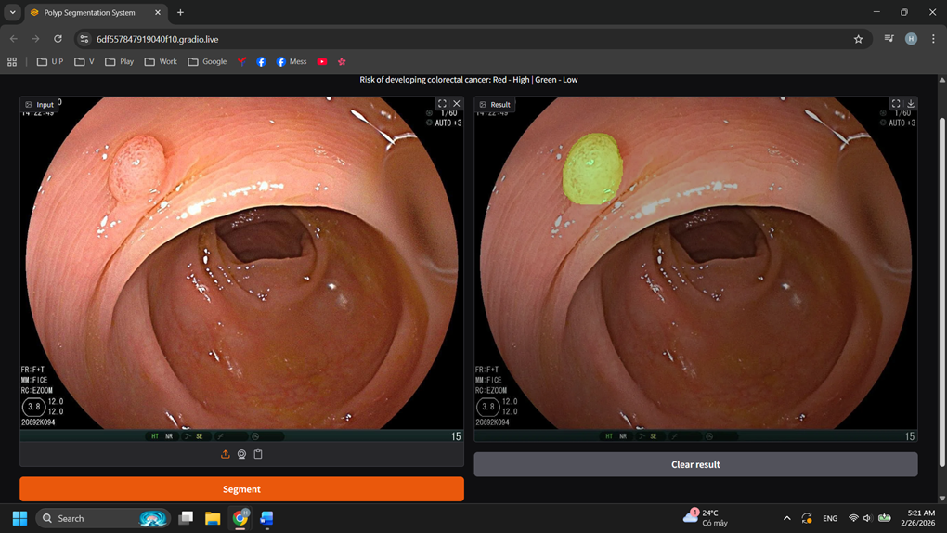
3 Product Overview
Green: Still safe | Red: Dangerous
Polyp Segmentation and Risk Assessment System
Computer vision
5

Slide 6
4 AI Methodology
(System’s brain)
Computer vision
6

Slide 7
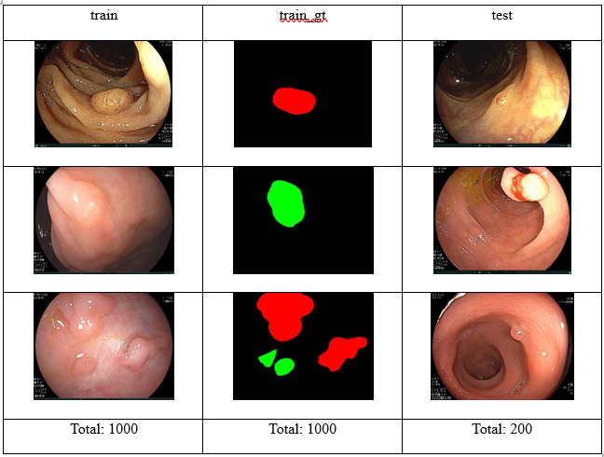
4.1 Dataset
Source: BKAI-IGH NeoPolyp https://www.kaggle.com/competitions/bkai-igh-neopolyp/data
Polyps’ color:
Red: malignant
Green: benign
Test set has no ground truth to make evaluations
Make our own test set by split the 2 train sets in an 8:2 ratio. 8 for train, 2 for test
Model choice: UNet++
Ability to capture detailed edge regions
Optimal processing speed for applications
Computer vision
7

Slide 8
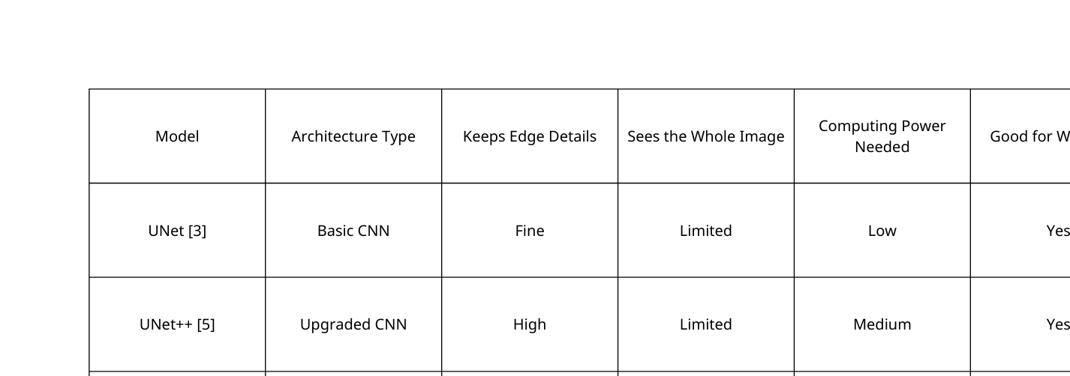
4.2 model selection
We chose the UNet++ [5] model to balance high accuracy with the ability to run smoothly on a website
Computer vision
8

Slide 9
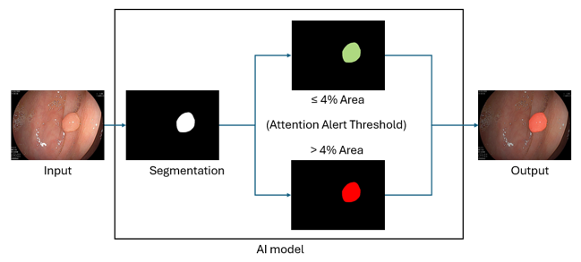
4.2 system pipeline
Input:
Raw endoscopic image
Resize + Normalize
Ensure all images go through the system meet the same standard conditions.
AI model:
Detect and segment boundaries of polyps
Assigns a color overlay to the original image
Red if the polyp occupies more than 4% of the frame area
Green otherwise
Output: The same input image but with a diagnostic overlay
Important note:
The camera always zoom in - out in an endoscopy
This system only acts as an attention filter to identify where the polyp is.
The final diagnosis still depends on the doctor.
Computer vision
9

Slide 10
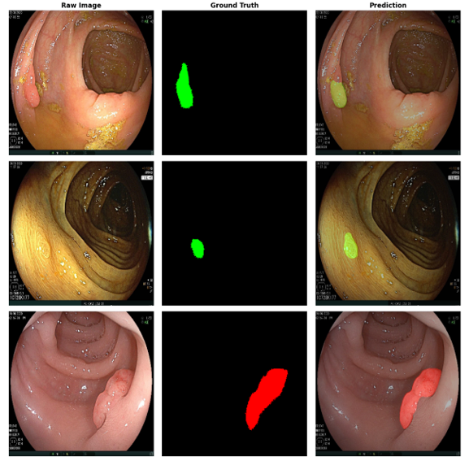
5 Evaluation
Quantitative evaluation: All metrics are good
Dice (0.9175): Overall prediction quality
IoU (0.8497): Polyp shape matching
Precision (0.9417): Reliability of alerts
Recall (0.8982): Detection completeness
Qualitative evaluation:
The predictions closely match the actuals on three examples
Computer vision
10

Slide 11
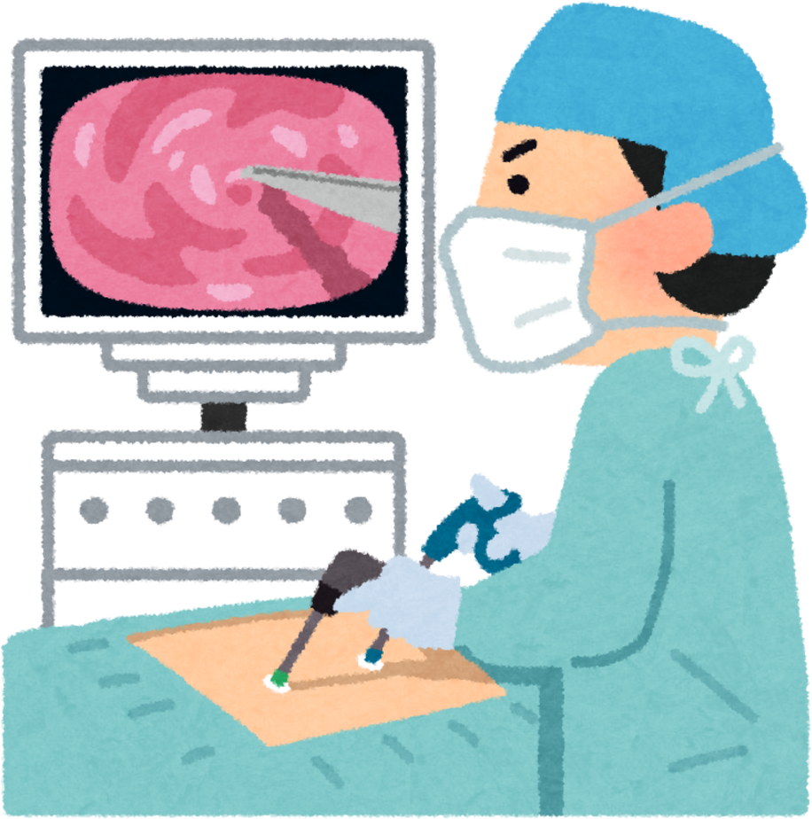
6 Conclusion
Our Polyp Segmentation and Risk Assessment System works effectively
High scores in evaluation
In experiment, it performs stably and accurately with un-trained data in original test set
This system will be a helpful assistant for doctors
It’s friendly for everyone
Future Work
Improve the model
Let the AI consider other factors such as blood vessels on polyp’s surface.
Ai can better understand whether the polyp is dangerous or not
System can work with live video
Computer vision
11

Slide 12
THANKS FOR YOUR ATTENTION
Computer vision
12

